Slide 1

OOP
Opentechz Pvt Ltd .
By Parthasarathi Swain

Slide 2

What is OOP? (OOP = Object-Oriented Programming)
Definition : OOP is a programming style where everything is represented as an object.
What is an object? An object is a real-world entity (like a car, student, or bank account) that has:
Why OOP?
Helps organize code around real-life things
Makes code modular – each class handles a specific part
Makes code reusable – write once, use again
Makes code maintainable – easier to debug and update
Popular OOP Languages:
C++ ,Java ,Python

Slide 3
Features of Object-Oriented Programming (OOP)
Class
Object
Encapsulation
Abstraction
Inheritance
Polymorphism

Slide 4

What is class ?
A class is a user defined data type or blue print or specification or logical constructor of an object.
A class is user defined of an object because using class we can store multiple object.
A class is called blue print of an object because using class we can create multiple objects of same type.
A class is called specification of an object because it specify what an object contains.
A class is also called logical constructor of an object because it constructs object logically(design) an object.

Slide 5
What is an Object ?
A object is real world things which is an instance of a class .
State: represent data of an object.
Behaviour: represent the behaviour (functionality) of an object such as deposit, withdraw, sleep, fooding....etc
Identity: An object indentity is typically implemented a via unique ID.

Slide 6

#include <iostream>
using namespace std;
class Dog {
public:
string name;
string breed;
int age;
void sleep() {
cout << name << " is sleeping." << endl;
}
};
int main() {
Dog dog1;
dog1.name = "Tommy";
dog1.breed = "Labrador";
dog1.age = 3;
dog1.sleep();
return 0;
}
class object relation

Slide 7
Members of a Class
Data Members (Variables / Attributes)
Member Functions (Methods)
Access Specifiers (public, private, protected)
Constructors
Destructors
Static Members

Slide 8
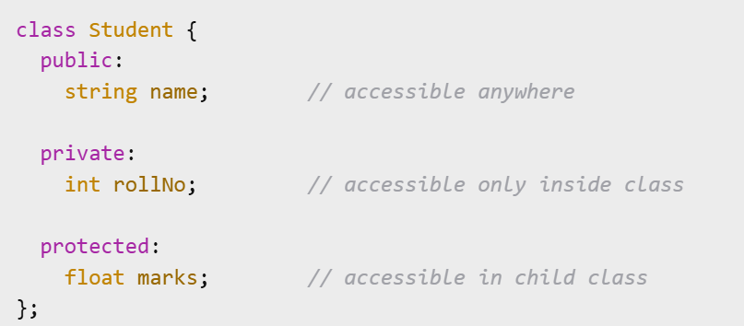
Access Specifiers in C++
Access specifiers control who can access class members (variables and functions).
public
Members are accessible from anywhere in the program.
private
Members are accessible only inside the class.
Not accessible from outside or from derived classes.
protected
Members are accessible inside the class and in derived (child) classes.
Not accessible from outside the class.

Slide 9
Thank You

